Slide 1
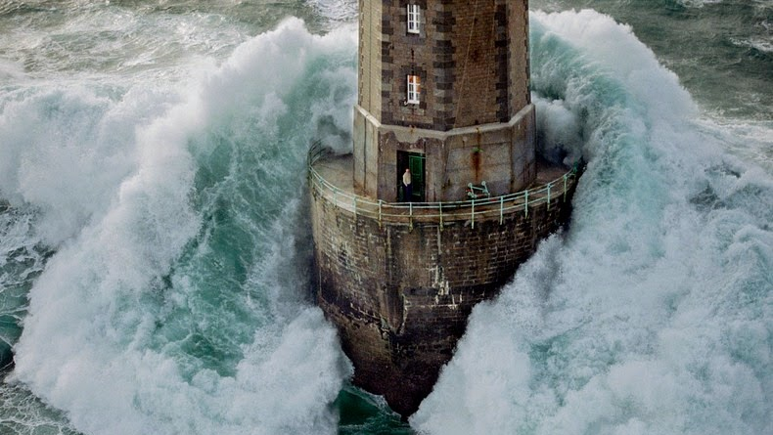
How to Take Refuge in God
Psalm 31
Notes:
Have you ever
Lived in a place where the weather was so bad
All you could do for a day or so was stay inside?

Slide 2
Psalm 31
O Lord, I have come to you for protection; don’t let me be disgraced. Save me, for you do what is right.
Turn your ear to listen to me; rescue me quickly.
Be my rock of protection, a fortress where I will be safe.
You are my rock and my fortress.
For the honor of your name, lead me out of this danger.
Pull me from the trap my enemies set for me,
for I find protection in you alone.
I entrust my spirit into your hand.
Rescue me, Lord, for you are a faithful God.
I hate those who worship worthless idols.
I trust in the Lord.
I will be glad and rejoice in your unfailing love, for you have seen my troubles, and you care about the anguish of my soul.

Slide 3
Psalm 31
You have not handed me over to my enemies
but have set me in a safe place.
Have mercy on me, Lord, for I am in distress.
Tears blur my eyes.
My body and soul are withering away.
I am dying from grief; my years are shortened by sadness.
Sin has drained my strength; I am wasting away from within.
I am scorned by all my enemies
and despised by my neighbors—
even my friends are afraid to come near me.
When they see me on the street, they run the other way.
I am ignored as if I were dead, as if I were a broken pot.
I have heard the many rumors about me,
and I am surrounded by terror.
My enemies conspire against me, plotting to take my life.

Slide 4
Psalm 31
But I am trusting you, O Lord,
saying, “You are my God!”
My future is in your hands.
Rescue me from those who hunt me down relentlessly.
Let your favor shine on your servant.
In your unfailing love, rescue me.
Don’t let me be disgraced, O Lord, for I call out to you for help.
Let the wicked be disgraced; let them lie silent in the grave.
Silence their lying lips—
those proud and arrogant lips that accuse the godly.
How great is the goodness
you have stored up for those who fear you.
You lavish it on those who come to you for protection,
blessing them before the watching world.
You hide them in the shelter of your presence,
safe from those who conspire against them.
You shelter them in your presence, far from accusing tongues.

Slide 5
Psalm 31
Praise the Lord,
for he has shown me the wonders of his unfailing love.
He kept me safe when my city was under attack.
In panic I cried out,
“I am cut off from the Lord!”
But you heard my cry for mercy
and answered my call for help.
Love the Lord, all you godly ones!
For the Lord protects those who are loyal to him,
but he harshly punishes the arrogant.
So be strong and courageous,
all you who put your hope in the Lord!

Slide 6
Learning from psalm 23
How to take refuge in God

Slide 7
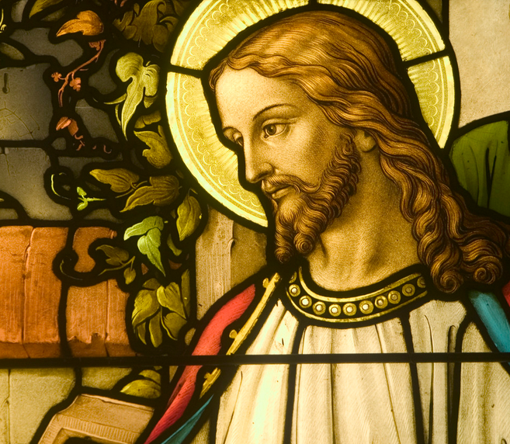
1. In hard times, run TO God, not AWAY
O Lord, I have come to you for protection;
don’t let me be disgraced.
Save me, for you do what is right.
Turn your ear to listen to me; rescue me quickly.
Be my rock of protection, a fortress where I will be safe.
Simon Peter replied, “Lord, to whom would we go? You have the words that give eternal life. (John 6:68)
Notes:
We all have storms in life
Some of our own making
Some not
What we need is not merely protection in this world
But from fear, hopelessness
Protection for our SOULS
John 6, things got hard, many people stopped following.
Disciples were arguing about it
Jesus asked “Do you want to leave me too?”
Peter replied“Lord, to whom would we go? You have the words that give eternal life.

Slide 8
2. Ask for Guidance
You are my rock and my fortress.
For the honor of your name,
lead me out of this danger.
If you need wisdom, ask our generous God, and he will give it to you. He will not rebuke you for asking.
But when you ask him, be sure that your faith is in God alone. Do not waver, for a person with divided loyalty is as unsettled as a wave of the sea that is blown and tossed by the wind. (James 1:5-7)
Notes:
HE guides us, not because we are good, but because HE is good

Slide 9
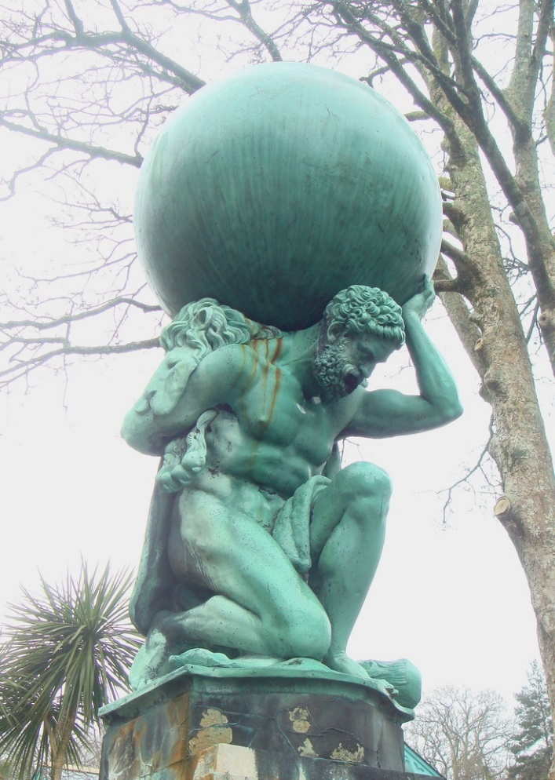

3. Give your entire life to God
I entrust my spirit into your hand.
Rescue me, Lord, for you are a faithful God.
Notes:
When we come to god and ask us to guide us
The first thing he is going to ask is not
What will you do for me if I get you out of this, BUT
Your life is only safe surrendered to me. THAT is the first step
As long as we are running our lives by our own wisdom and leading, and not God’s, he cannot help us
STORY: running your life v. committing it to the one who can teach you
Into your hands I commit my spirit

Slide 10
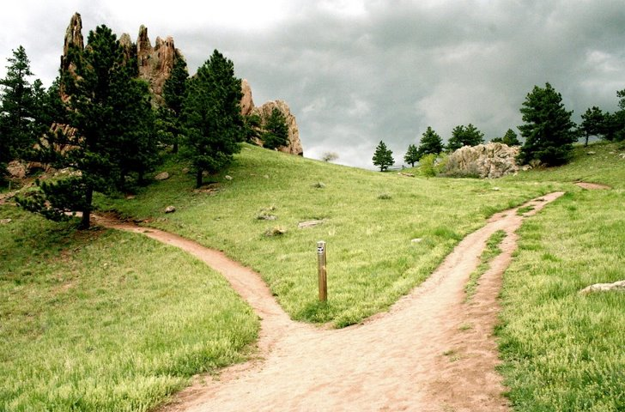
4. Hate every false way
I hate those who worship worthless idols.
I trust in the Lord.
Through your precepts I get understanding; therefore I hate every false way.
(Psalm 119:104)
Notes:
You’ve got to leave your old ways
Even Christians have ways that need to change
Every false comfort!
Every old habit!
Old friends who want to pull you down!

Slide 11
5. Remember God SEES and CARES
I will be glad and rejoice
in your unfailing love,
for you have seen my troubles,
and you care about the anguish of my soul.
Notes:
Jesus wept many times
Including for his friend Lazarus and family
Even though he was going to raise him from the dead
Even our temporal suffering Jesus cares about
But his solution is the coming kingdom
Which we must announce to others
And demonstrate in our hearts and souls and relationships and church

Slide 12
6. Pour out our COMPAINTS to God
Have mercy on me, Lord, for I am in distress.
Tears blur my eyes.
My body and soul are withering away.
I am dying from grief; my years are shortened by sadness.
Sin has drained my strength; I am wasting away from within.
I am scorned by all my enemies
and despised by my neighbors—
even my friends are afraid to come near me.
When they see me on the street, they run the other way.
I am ignored as if I were dead, as if I were a broken pot.
I have heard the many rumors about me,
and I am surrounded by terror.
My enemies conspire against me, plotting to take my life.
Notes:
Years shortened with sadness
Divorce
Bankruptcy
Guilt
Worry
Addiction

Slide 13
7. Trust Him to Do Something
But I am trusting you, O Lord,
saying, “You are my God!”
My future is in your hands.
Rescue me from those who hunt me down relentlessly.
Let your favor shine on your servant.
In your unfailing love, rescue me.

Slide 14
8. Love God and Persevere
Love the Lord, all you godly ones!
For the Lord protects those who are loyal to him,
but he harshly punishes the arrogant.
So be strong and courageous,
all you who put your hope in the Lord!

Slide 15
SUMMARY
In hard times, run TO God, not AWAY
Ask for Guidance
Give your entire life to God
Reject every false way
Remember that God sees and cares
Pour out your complaints to God
Trust Him to do something!
Love Him and persevere
How great is the goodness
you have stored up for those who fear you.
You lavish it on those who come to you for protection,
blessing them before the watching world.

